Slide 1
Shopping App
An app for online shopping

Slide 2
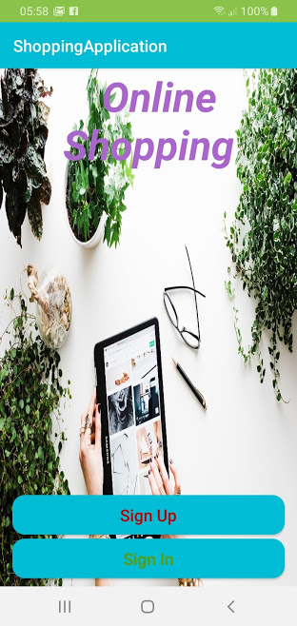
The Team
Abdullah Abbas Barahow
Aklilu Ghebremedhin 0001
Karl Ingemar Javier Lundh
Lavdim Imeri
Robert Alm

Slide 3
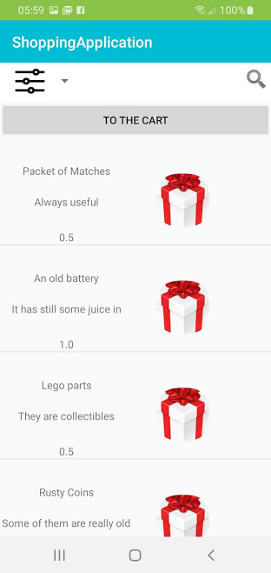
Shopping app
As online shopping becomes more and more prominent, android developers around the world compete to create apps that can cover the needs of the buyer.
Our focus was to create a simple and light app that will allow the user to make his purchases as quickly, easy and safely as possible

Slide 4
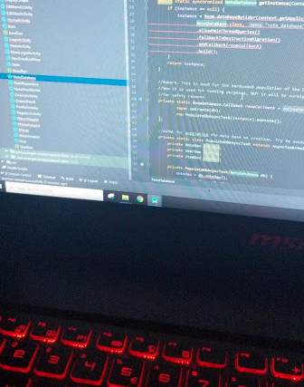
What could have been better?

Slide 5
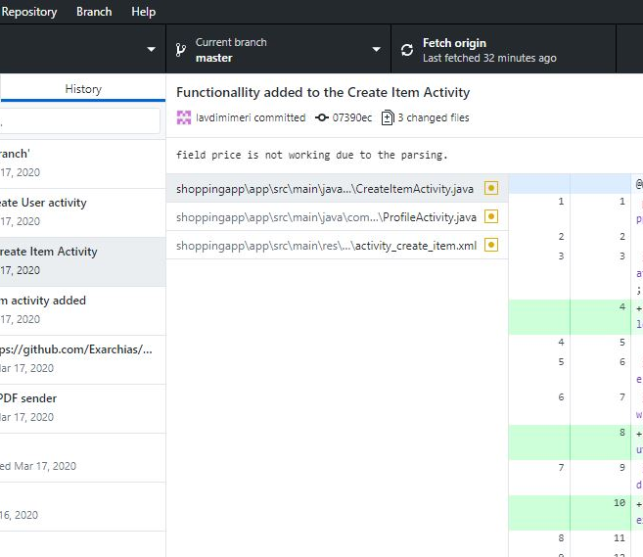
Git and GitHub
Avoiding conflicts it is always a struggle
GitHub Desktop it is a good tool to use
The use of branches was helpful to avoid conflicts
Conflicts need patience to be solved correctly
Git and GitHub are both a great fun!

Slide 6

Future plans
The Admin would be able to see everything from the user’s perspective
The Admin will be able to have an overview of the orders
The app will be able to track the inventory and to inform users and admins about it
Better Design
More intuitive UX, (User Experience)
Live Data
Better Security

Slide 7

Meetings

Slide 8
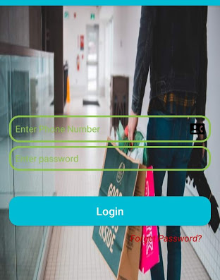
Login and Register
The user can login, register, or reset their password
Reset password verifies the user through SMS
The passwords are stored encrypted in hash encryption
For the login the telephone of the user is used and a password

Slide 9
Dashboard
Dashboard is the home page for the whole app
A side bar offers access to the shopping card, to the purchase history, to settings and to logout button.
All the items that the user can buy are displayed on the Dashboard. The user can select the easily and add them to the shopping cart
When the user is admin, then she has access to the Admin panel

Slide 10
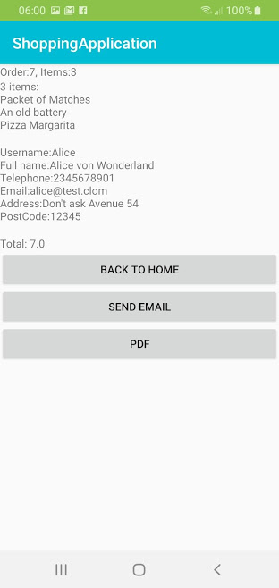
Shopping Cart and the Invoice
The user can add any available item in his shopping cart where he can confirm the order
If the user confirms a checkout, then the transaction is completed, and he gets to the display of the invoice of the order
When in the invoice page, the user has the option to have an email with the invoice or a pdf

Slide 11
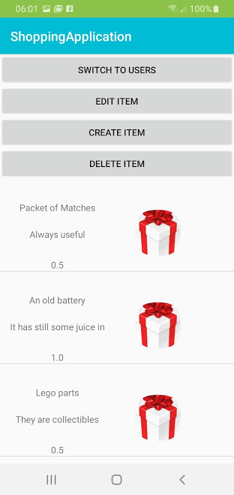
The Admin Panel
The admin can easily overview the available items and the registered users
The design is very intuitive and allows the admin to work easily
The admin can create, edit and delete both items and users

Slide 12
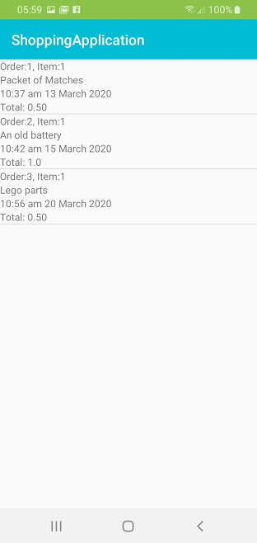
Purchase History
The user can see the history of his activity and his orders at any time through the “Display Orders” panel which displays the orders
Each order has a title and a detailed description and displays the sum and the time of each order

